Slide 1
Basic Computer Organization and Design
Instruction Codes
Computer Registers
Computer Instructions
Timing and Control
Instruction Cycle
Input Output and Interrupt

Slide 2
Instruction codes
Instruction code
A group of bits that instructs the computer to perform a specific operation.
Usually divided into parts--- each having its own particular interpretation
Operation code (op-code) (Most basic part)
a group of bits that defines operations as add, subtract, multiply, shift, complement etc.
Other part of an instruction may specifies the register or memory where the operands are to be found, as well as the register or memory where the operands are to be stored
Note: Number of operation codes for any machine are finite. So the number of bits assigned to an op-code is also finite. The op-code must consist of at least n bits for a given 2^{n} (or less).

Slide 3
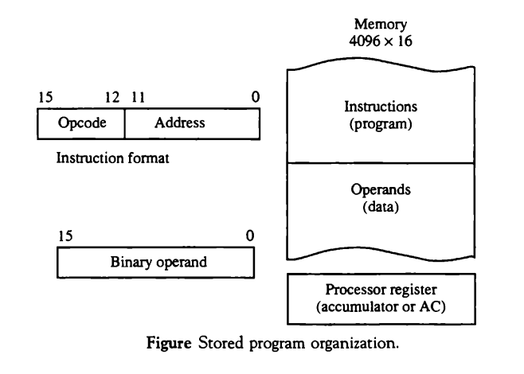
Stored Program Organization (Basic computer)

Slide 4
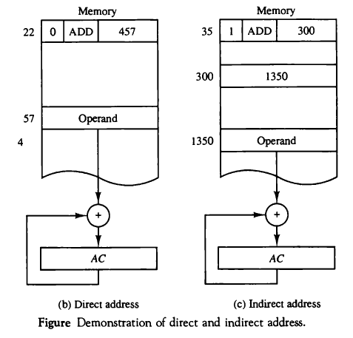
Direct and Indirect Address
Effective address: An address of the operand in a computation type instruction or target address in a branch type instruction
Immediate instruction: Instruction in which second part specifies operand

Slide 5
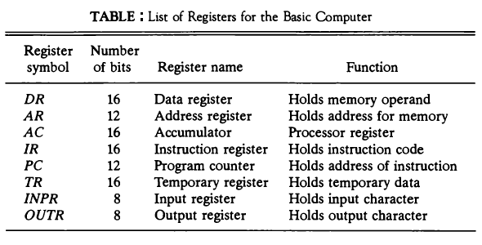
Computer Register

Slide 6
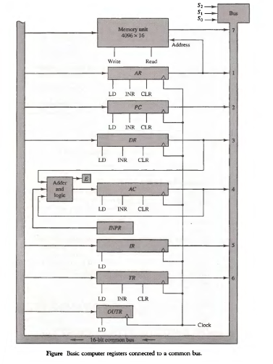
COMMON BUS SYSTEM

Slide 7
Computer Instruction Format
Basic computer has three instruction code format:
Memory reference instruction
Register reference instruction
I/O reference instruction

Slide 8
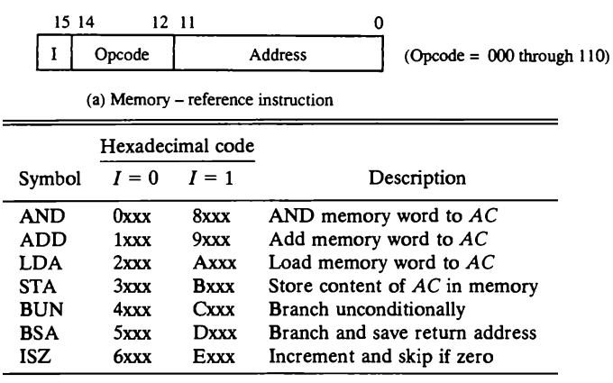
Memory Reference Instruction

Slide 9
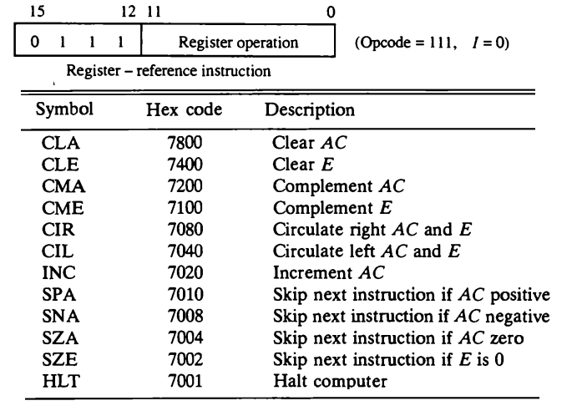
Register Reference Instruction

Slide 10
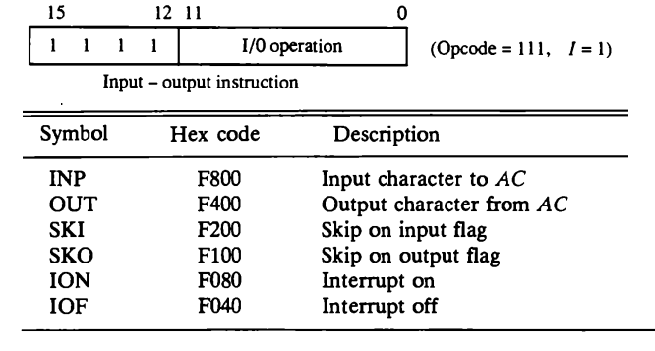
Input – Output Instruction

Slide 11
Instruction Set Completeness
The set of instructions are said to be complete if the computer incudes a sufficient number of instructions in each of the following categories:
Arithmetic, logical, and shift instructions
Memory transfer instruction
Program control instruction
Input and Output instructions

Slide 12
Control unit
Control unit generates control signal and provides control inputs for the multiplexers in the common bus, control inputs in processor registers, and micro-operations for the accumulator
There are two types of control organization:
Hardwired Control
CU is made up of sequential and combinational circuits to generate the control signals.
If logic is changed we need to change the whole circuitry
Expensive
Fast
Micro-programmed Control
A control memory on the processor contains micro-programs that activate the necessary control signals
If logic is changed we only need to change the micro-program
Cheap
Slow

Slide 13
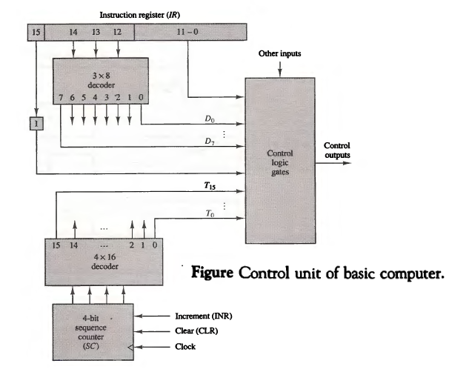
Block diagram of hardwired CU

Slide 14
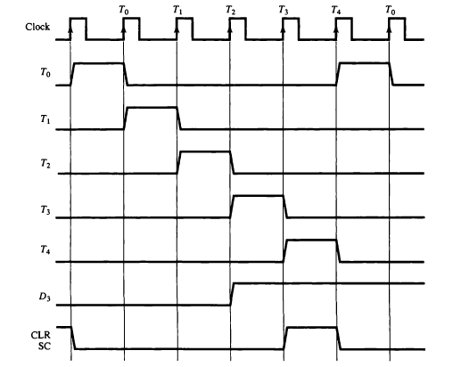
Example of Control Timing Signals
SC is incremented to provide timing signal T0,T1,T2,T3,T4 in sequence. At Time T4 SC is cleared to 0 if decoder output D3 is active.
i.e. D3T4: SC ← 0

Slide 15
Instruction Cycle
Instruction cycle is defined as the time required for completing the execution of an instruction.
Phases of Instruction cycle:
Fetch an instruction from memory
Decode the instruction
Read the effective address from memory if the instruction has an indirect address
Execute the instruction

Slide 16
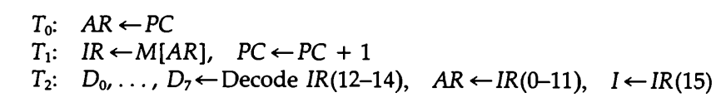
Fetch and Decode
The micro-operations for the fetch and decode phases can be specified by:

Slide 17
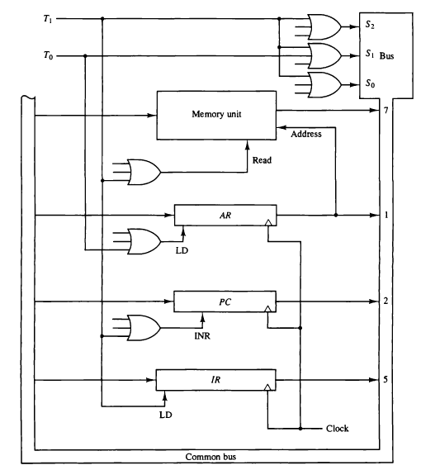
Register Transfers for the Fetch Phase

Slide 18
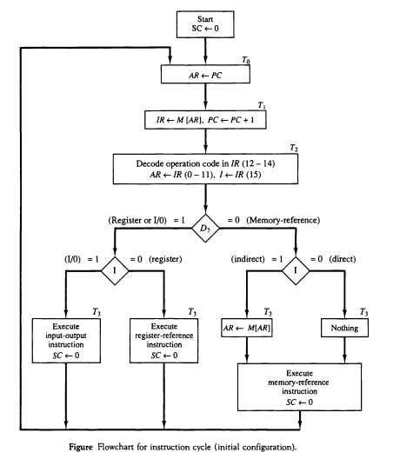
Determine the type of instruction
Flow Chart for Instruction Cycle

Slide 19
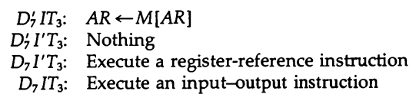
Contd..
The three instruction types are divided into four separates paths
The selected operation is activated with the clock transition associated with timing signal T3.
This can be symbolized as:

Slide 20
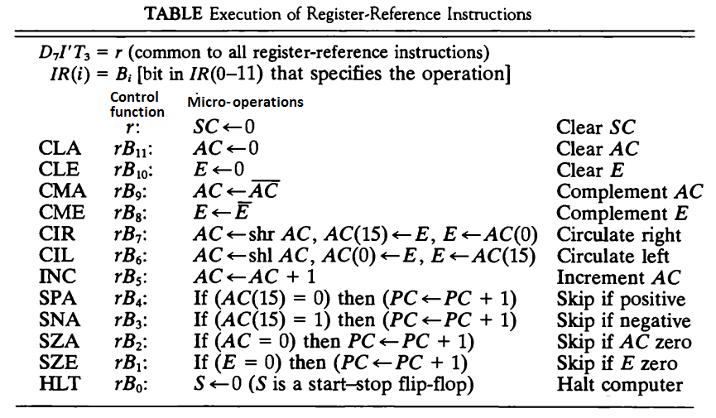
Register reference instruction

Slide 21
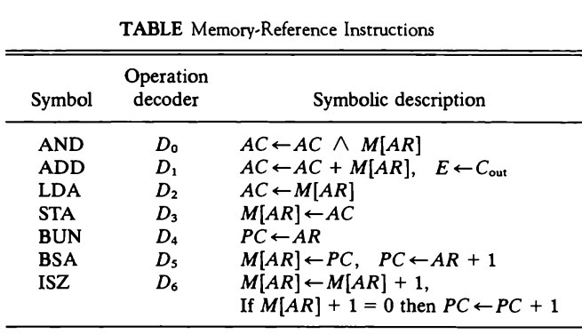
Memory Reference instructions

Slide 22




(micro-operation that executes memory ref. instruction) Contd..
AND
ADD
LDA
STA
BUN
BSA
ISZ

Slide 23
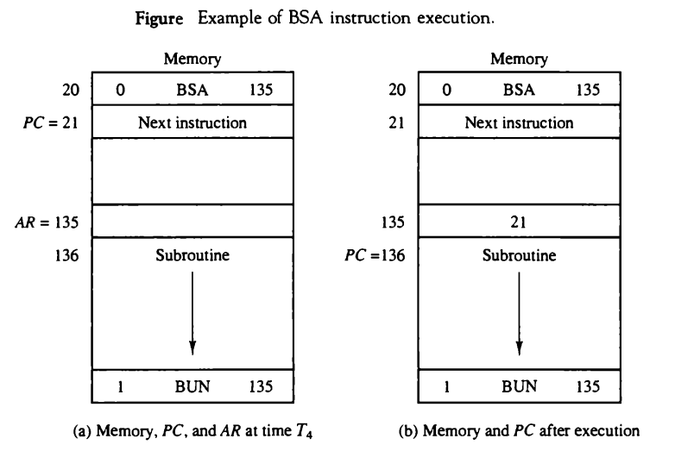
Example of BSA instruction execution

Slide 24
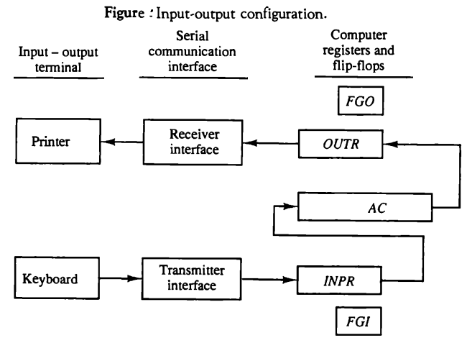
Input-Output Configuration

Slide 25
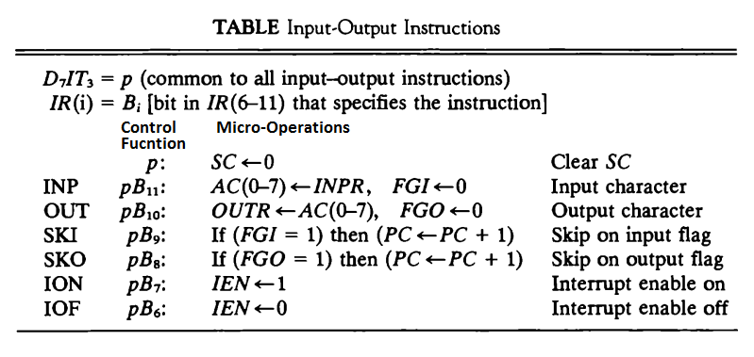
Input-Output instructions

Slide 26
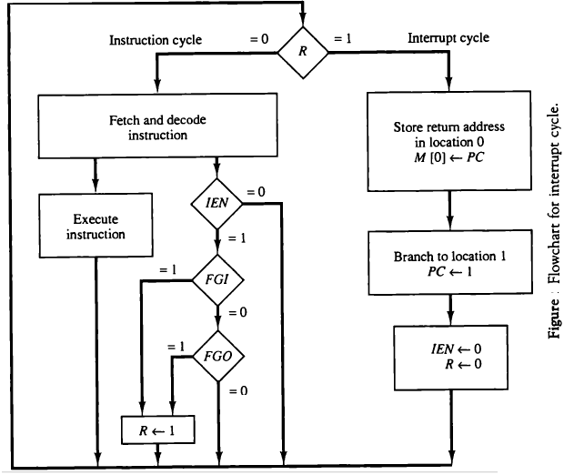
Program Interrupt

Slide 27
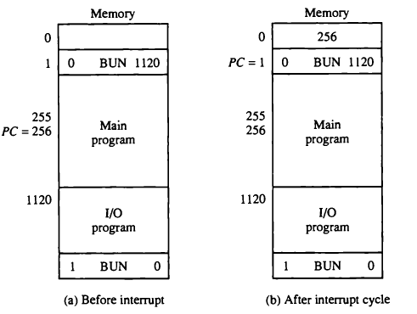
Demonstration of Interrupt cycle

Slide 28
Assignment
Differentiate between programmed controlled transfer and interrupt transfer.
Explain the flowchart for interrupt cycle.

